Slide 1

Final Project
By: Aidan Tata-Lobo

Slide 2
Purpose
To help improve the overall quality and increase amount of viewership for shows and movies
Helps benefits the Netflix audience and Netflix stakeholders

Slide 3
Methodology
Netflix dataset from Kaggle
CSV file
Jupyter notebooks

Slide 4
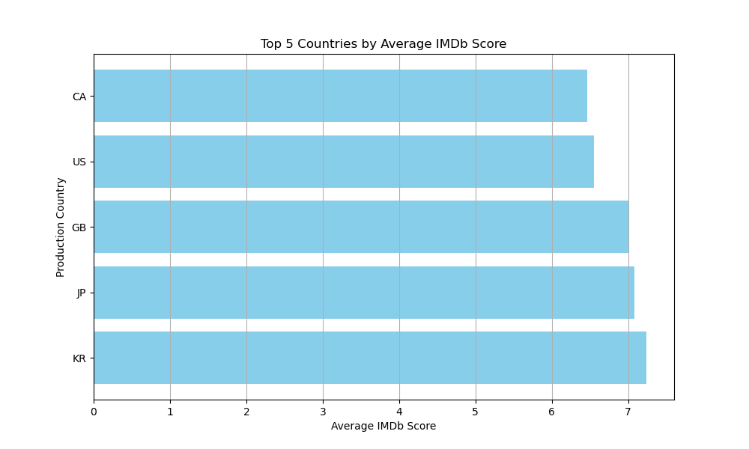
2 Asian (#1 & #2)
1 European (#3)
2 North American (#4 & #5)
Over 100 value count
South Korea, Japan, Great Britain, United States and Canada

Slide 5
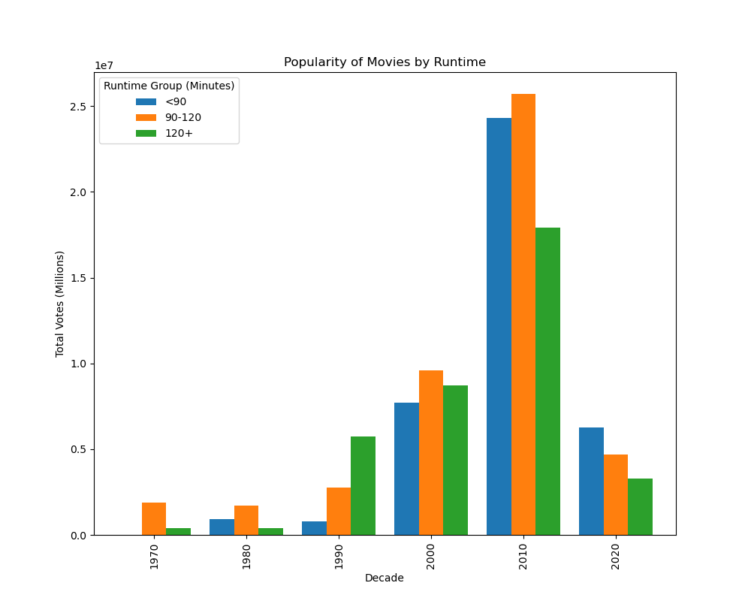
Overtime shorter movies become have become popular
Started with 2+ hours being the most popular
First two decades no strong patterns

Slide 6
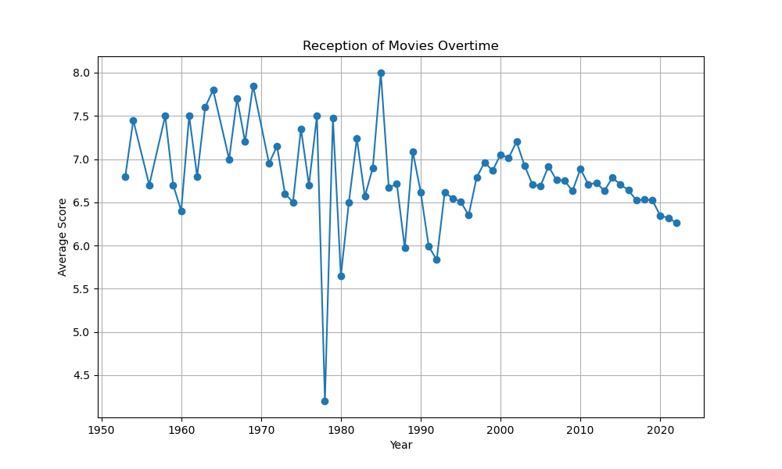
1950’s to 2000’s jumps between 6.0 to 8.0
Steady decline after 2000’s

Slide 7
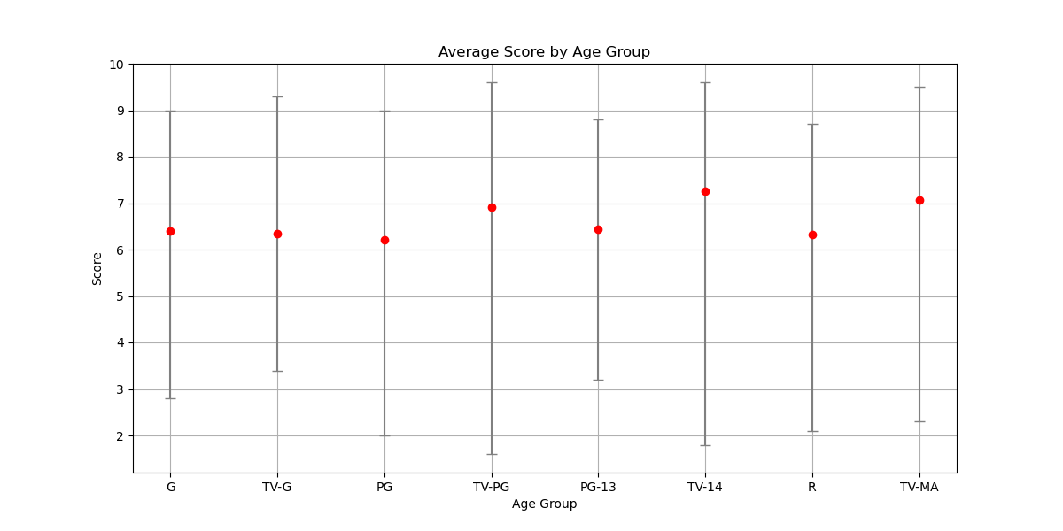
Tv Shows perform better than movies in all age groups
TV-G and G have about same score
0.5 difference in average score

Slide 8
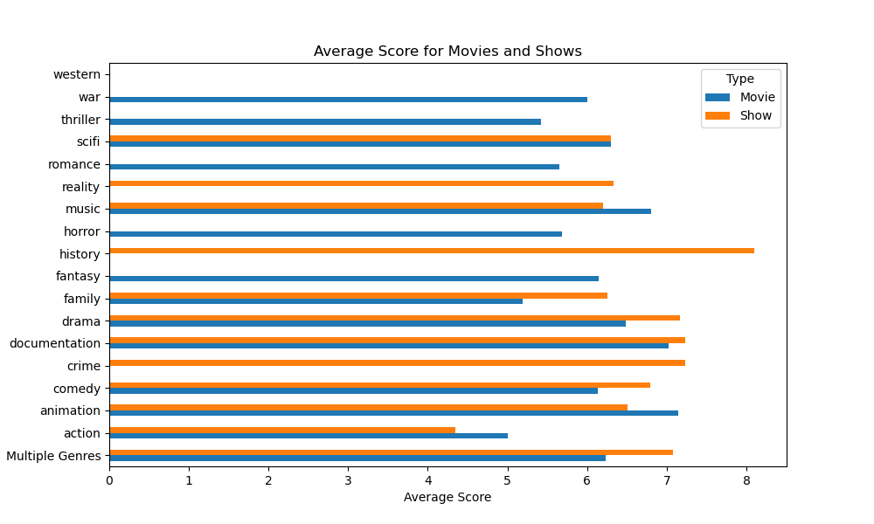
No strong correlation
Reality and history shows
50/50 divide on having a higher score

Slide 9
Future Work
Leaning more towards countries like Japan and South Korea
Keep in mind their audience and focus on shorter length entertainment products
Focus on more TV shows or improving the quality of movies
There are many factors can be successful critically and commercially
Look more deeply into how multi-genre and multi-country produced products

Slide 10
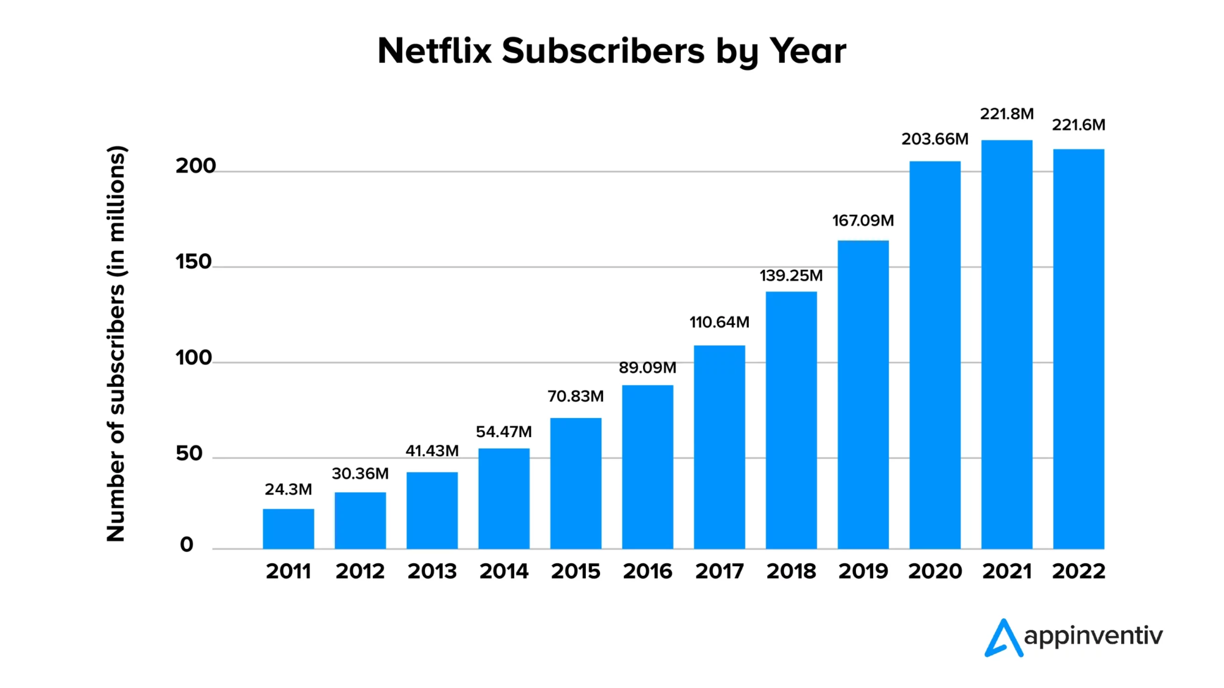
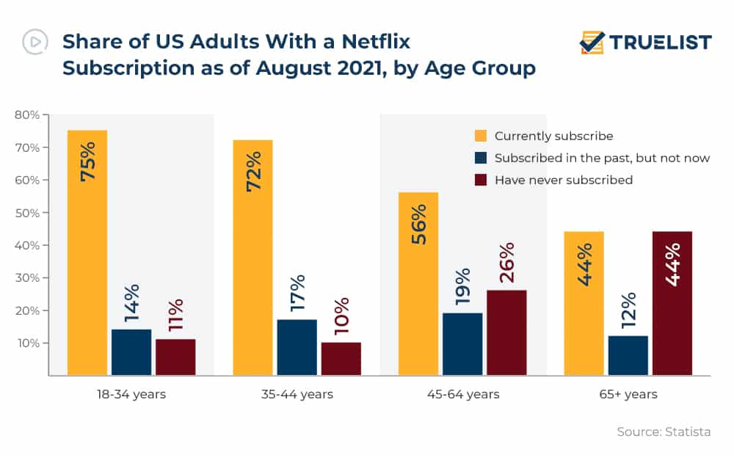
Appendix
Data cleaned: Removed Seasons, Product ID
Password sharing crackdown, price increase on subscriptions

